Slide 1

Restaurant recommender system
Coursera Data Science Professional Capstone project.

Slide 2
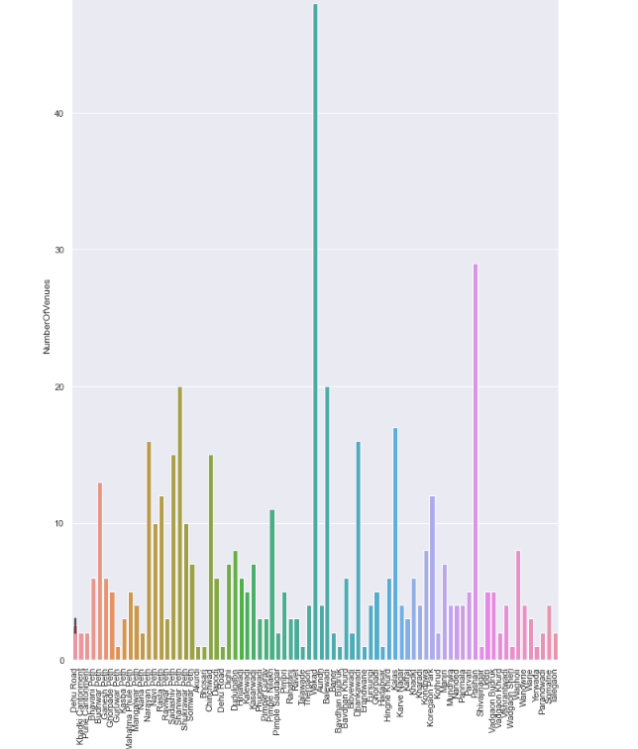
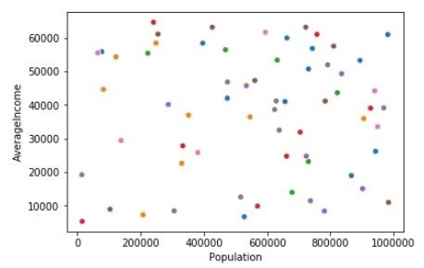
Methodology
Recommender System
Machine learning
Exploratory analysis
Inferential analysis

Slide 3
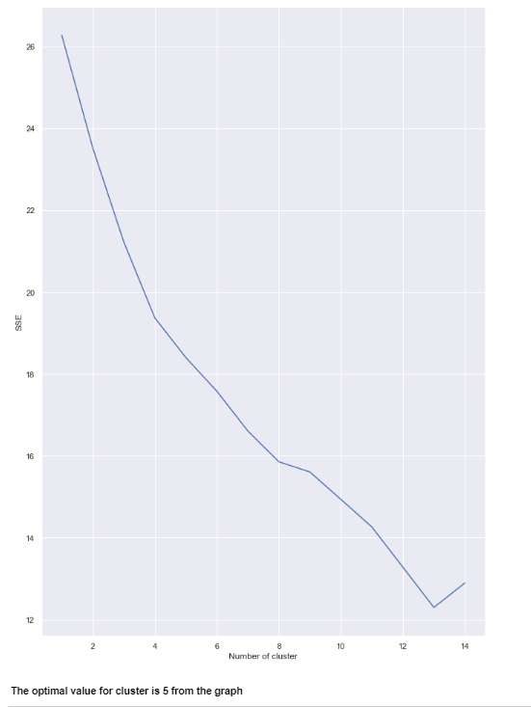

Slide 4
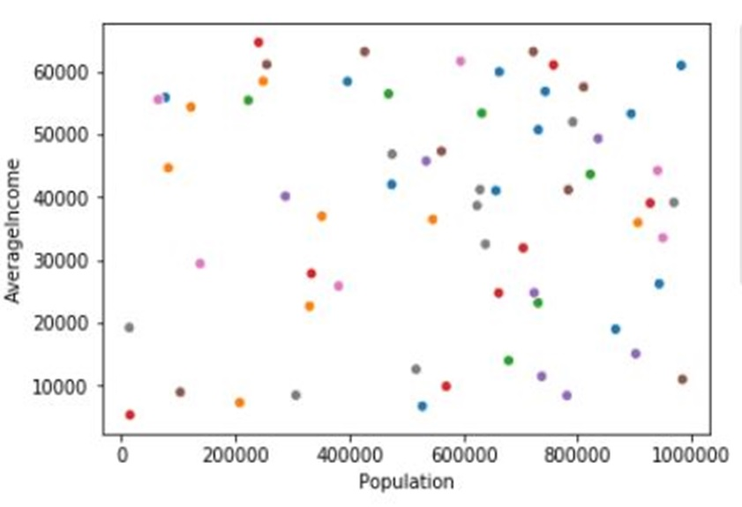

Slide 5
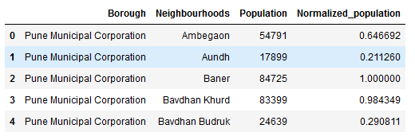

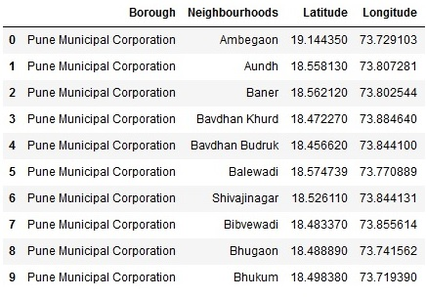

Datasets

Slide 6

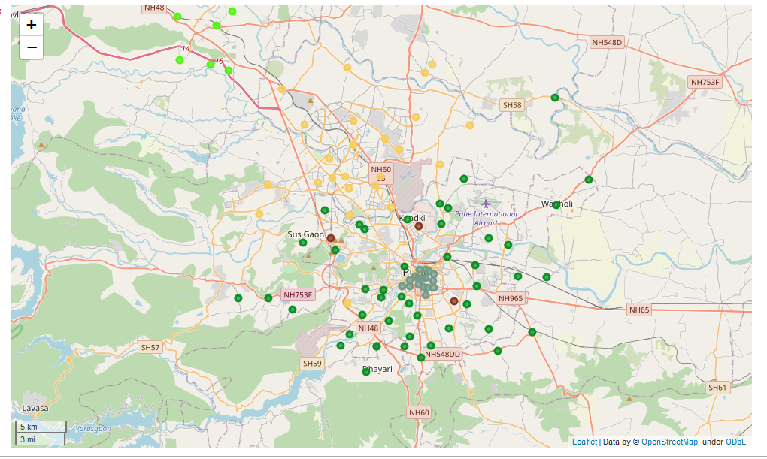
Mapping and clustering

Slide 7
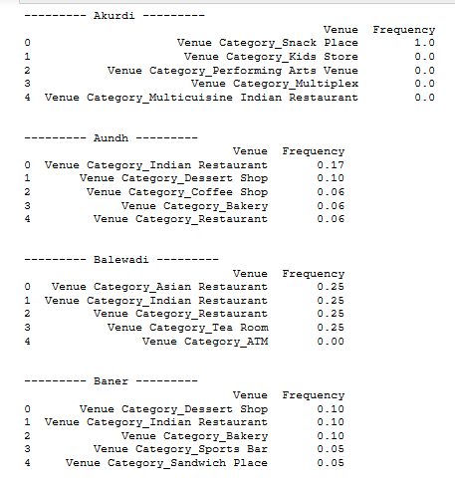

Results and conclusion

Slide 8

Thank You!
jaysonnapster@gmail.com

